Slide 1
Dissertation Writing:
Workshop
Dr Nischal Khandai

Slide 2
What is Research?:
Research can be referred to as a systematic way of answering questions about the world.
Aims:
  developing knowledge for processes of discovering new ideas or innovations;
  developing an understanding of the natural laws governing the universe;
  commitment to pursuing and achieving scientific excellence, and
  the pursuit of scientific and technological advantages which will improve the welfare of mankind.
All human beings regularly engage in some form of research.

Slide 3
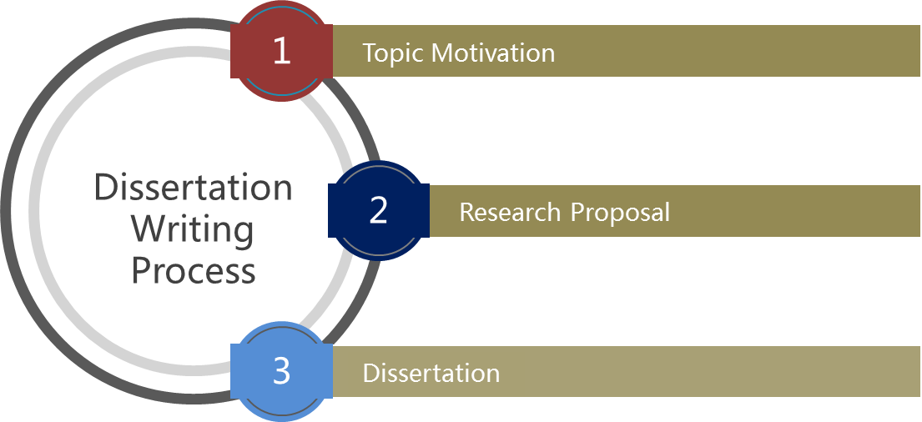
Dissertation Writing Process:

Slide 4

1. Topic Motivation
Choose an area of interest, usually a problem area.
Consider the organisation that you work in.
Management/business perspective- MBA requirement (coursework)
Avoid ambiguous and broad topics (i.e. longitudinal studies)

Slide 5
Refrain from developing topics based on the premise of providing recommendations.
Choose a topic that investigates a problem, with proposed recommendations as an objective of the study.

Slide 6

  REQUIREMENTS FOR TOPIC SUBMISSION

Slide 7
  Title of Study
  *Discuss examples
  Variables?
  Avoid topics with excessive variables
  What are the possible areas of research?
  The Aim of the Study
  What will your study achieve?
  The Objectives of the Study.
    1)
    2)
    3) Should be a recommendation
    *Discuss examples

Slide 8
  The expected research outcomes (expected results of the proposed investigation)
  Details of how data/information to carry the empirical research will be collected:
    Qualitative or quantitative?
    Data collection tool?
    Who will the target population be? (Occupational category?)
    Target population size & sample size?
    Setting of study? (Which organisation/s will your study be based on?)

Slide 9
2. Research Proposal
Introduction
Background to the Problem
Aim Of the Research
Research Objectives
Research Questions
Research Problem/Hypothesis
Significance of the Research
Literature Review

Slide 10
  Research Methodology
  Research Strategy (Quantitative/Qualitative)
  Target Population and Sample
  Sampling Strategy
  Data Collection Instruments
  Validity and Reliability
  Data Analysis

Slide 11
  Pilot Study
  Limitations of the Research
  Elimination of Bias
  Ethical Consideration
  Format of the Research (Chapter Organisation)
  Proposed Timetable/ Timeline
  Bibliography

Slide 12
2. Research Proposal
Background to the Problem
  Sets the stage for problem that will be researched
  Facts about the problem
Aim Of the Research
  Formulate a clear and definite aim that sheds light on the whole topic.
  For example: The aim of this study is to investigate the impact of employee motivation on organisational performance.

Slide 13
Research Objectives
Research Questions
To identify the factors affecting employee motivation
To investigate the impact of employee motivation on organisational performance
To offer recommendations/strategies to improve employee motivation levels
What are the factors affecting employee motivation?
What is the impact of employee motivation on organisational performance?
What are the recommendations/strategies to improve employee motivation levels?

Slide 14
2. Research Proposal
Research Problem
  What is the actual problem?
  Provide an understanding of what research will be about
  Purpose, nature & reasons for study
  Context & circumstances

Slide 15
2. Research Proposal
Significance of the Research
  Why is the research worth undertaking?
  How will results of the study be used?
  Who will benefit?

Slide 16
2. Research Proposal
Literature Review
  Provides a conceptual framework,
  Structure according to research objectives
  Select most important and relevant theories, models and studies pertinent to your study.
  Sources: Use credible journal articles, papers, books
  Use current literature [not more than five years old]

Slide 17
2. Research Proposal
Literature Review
  Ensure a thorough mix of existing research articles and theory
  Do not dominate the review with a few references

Slide 18
  Research Methodology
    Qualitative or Quantitative?
    Justification?
  Research Strategy
    Survey
    Case study
    Combined strategy
    Justification

Slide 19
  Target Population and Sample
    Relevance of target population to study
    Define target population
    Specify size of target population
    Specify size of sample
  Sampling Strategy
    Probability Vs Non-Probability
    Rationale for choice

Slide 20
Probability Sampling
Simple random | Each population element has an equal chance of being selected into the sample. Sample drawn using random number table/ generator
Systematic | Selects an element of the population at a beginning with a random start and following the sampling fraction selects every kth element.
Stratified | Divide population into sub-populations or strata and use simple random sample on each strata.
Cluster | Population is divided into internally heterogenous sub-groups

Slide 21
Non-Probability Sampling
Haphazard/convenience | The researcher selects a sample that is convenient.
Quota | A sample in a predetermined group is selected.
Purposive/ judgemental | The researcher will select anyone in a hard-to-find target population
Snowball: | The researcher will select a sample that connected to one another.

Slide 22
  Data Collection
    Define
    Justification
    Questionnaires
    Interviews (Structured/Unstructured)
    Observations

Slide 23
  Validity
    Potential of a design or measuring instrument to measure what is supposed to achieve and or measure
    The researcher must cite the following types of validity and then explain how he applied them to his instrument:
    Content validity (representation of all elements?)
    Criterion- related validity (is the measure related to outcome?)
    Construct validity (measures its claim?)

Slide 24
  Reliability
    This pertains to the accuracy of measures.
    The same instrument must be able to produce the same data at a later stage under similar conditions.
    The researcher may do this by means of a test – retest (2 occasions)

Slide 25
  Data Analysis
    Qualitative or Quantitative?
    Rationale?
    Quantitative (Statistical techniques? Inferential: beyond description- judgements/conclusions can be inferred or explained; or descriptive statistics: describe basic features of data)
    Qualitative: Thematic analysis; Content Analysis; NVivo

Slide 26
  Pilot Study
    Pre-test
    Feasibility
    Possible flaws and improvements
    Relevance
    Amendments

Slide 27
  Limitations of the Research
    Shortcomings or restrictions
    E.g. Methods
  Elimination of Bias
  Use of gender neutral words
  Identifying people by race or ethnic group unless it is relevant
  Avoid language that suggests evaluation or reinforces stereotypes
  Making assumptions about various age groups

Slide 28
  Ethical Considerations
    Ensuring Participants have given Informed Consent
    Ensuring no Harm Comes to Participants
    Ensuring that Permission is Obtained
    Ensuring Confidentiality and Anonymity

Slide 29
  Format of the Research (Chapter Organisation)
  Proposed Timetable/ Timeline
  Bibliography

Slide 30
Please ensure that the following documents are included in your proposal before submission and that all headings above are adhered to:
Documents to be included:
  Ethical Clearance Form
  Permission Letter from the Company
  Draft Questionnaire (5 point Likert Scale)/Interview Schedule

Slide 31
Steps in the Research Process:
Selection and formulation of the research problem:
Selecting a topic for research: identification of the problem;
Formulating the research problem;
Acquiring knowledge on current theory and research:
Literature review;
Identifying and labeling the variables;
Defining concepts and establishing operational definitions;
Formulating the hypothesis/ present research problem.

Slide 32
2. Choice of research design
Research format and research design;
Description of the samples;
Sampling procedures.
3. Data collection
Construction of the research instrument;
Actual data gathering.

Slide 33
4. Analysis of data
Data processing;
Statistical analysis.
5. Interpretation of results
6. Conclusions and recommendations
7. Writing the research report

Slide 34

3. Dissertation
Structure

Slide 35
Cover page
Title page
Abstract
Declaration
Acknowledgements
Table of Contents
List of Tables
List of Figures
List of Acronyms
Chapter 1 – Introduction
Chapter 2 – Literature Review
Chapter 3 – Research Methodology
Chapter 4 – Results, Discussion and Interpretation of Findings
Chapter 5 – Conclusions and Recommendations
Bibliography
Appendices

Slide 36


Slide 37
Referencing
 | In-Text | Bibliography
Book | Smith (2015:58) claimed that … | Smith, D. (2015). Elements of Management. London: McMillan.
Electronic Journal | Johnson (2015) argued that democratic leaders welcome employee participation. Or Democratic leaders welcome employee particpation (Johnson, 2015). | Author, initials. (Year). Title. Journal title [online], volume (issue), location within host. Available at: URL [Accessed Date]. Johnson, M. (2015). Leadership in Africa. African Journal of Management [online] vol. 87(5). Available at: http://commerceinfo.com [Accessed 5 October 2015].

Slide 38
Referencing
 | In-Text | Bibliography
Internet: Web document | Lane (2013) claimed that … Or Technology is advancing at a rapid rate in the workplace (Lane, 2013). | Author. Year. Title. Place: Publisher (if available). Available at: web address of document [Accessed: day Month year]. Lane, C. (2013). The future of professionalised work: UK and Germany compared [Online]. London: Anglo-German Foundation for the Study of Industrial Society. Available at: http://www.agf.org.uk/pubs/pdfs/1232web.pdf [Accessed: 10 May 2014].
Internet Website | The population of SA is 55.6 million (Statistics SA, 2016). | Statistics South Africa. (2016). Community survey. Available at: http://cs2016.statssa.gov.za/ . [Accessed: 10 May 2016].
Government Publication | According to the Department of Health (2014), the number of nurses employed | Department of Health. (2014). Choice and opportunity: primary care: the future. CM 3390, London: Stationery Office. Available from URL [Accessed Date].

